Slide 1
Instruction
Segment (with polygon) fish that are close to the camera
Not very small fish.
Not fish behind many others
Not to fussy
If the name of the folder is “interior MAX 300” then, do not annotate all images. Stop when you reach ~300 fish
Some examples after

Slide 2
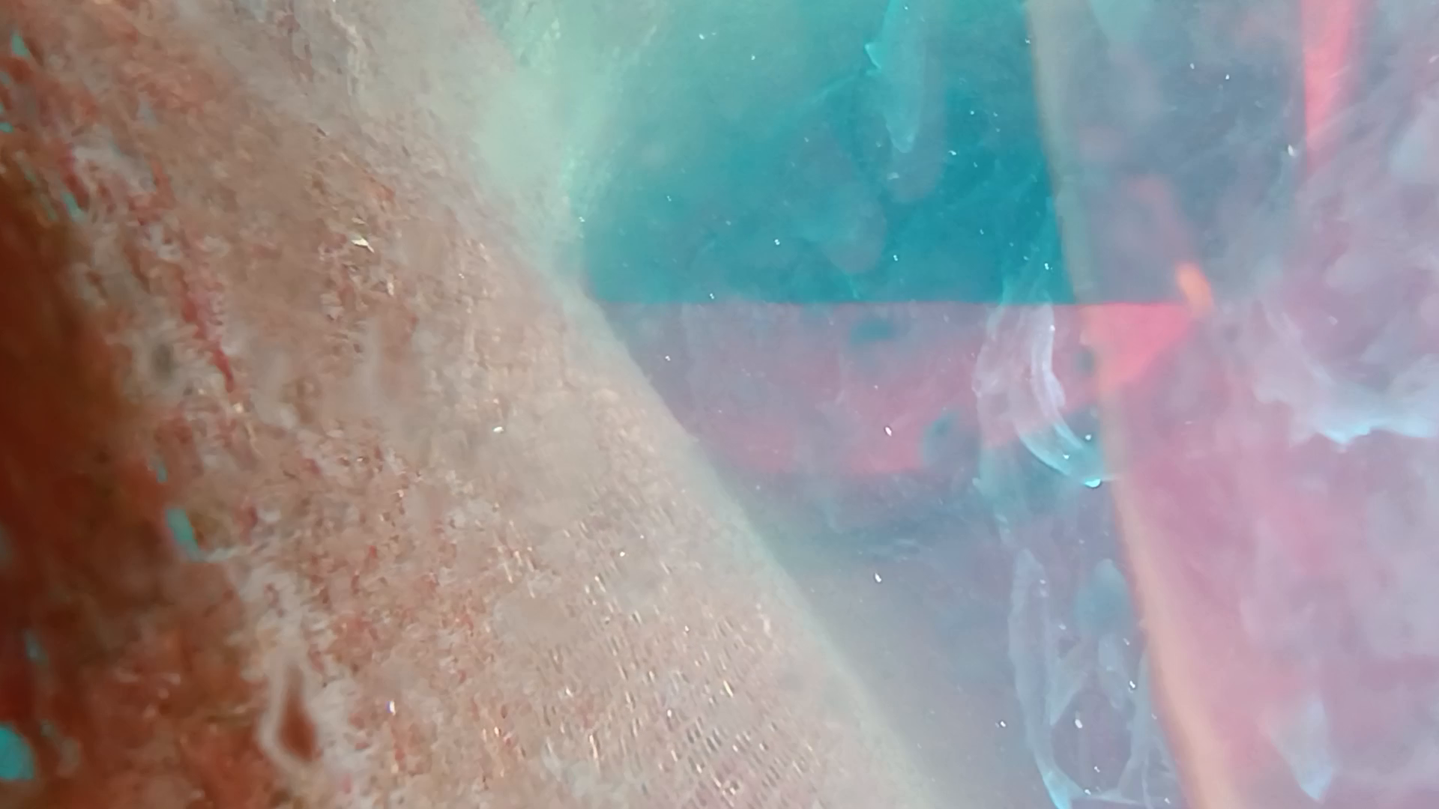

Slide 3
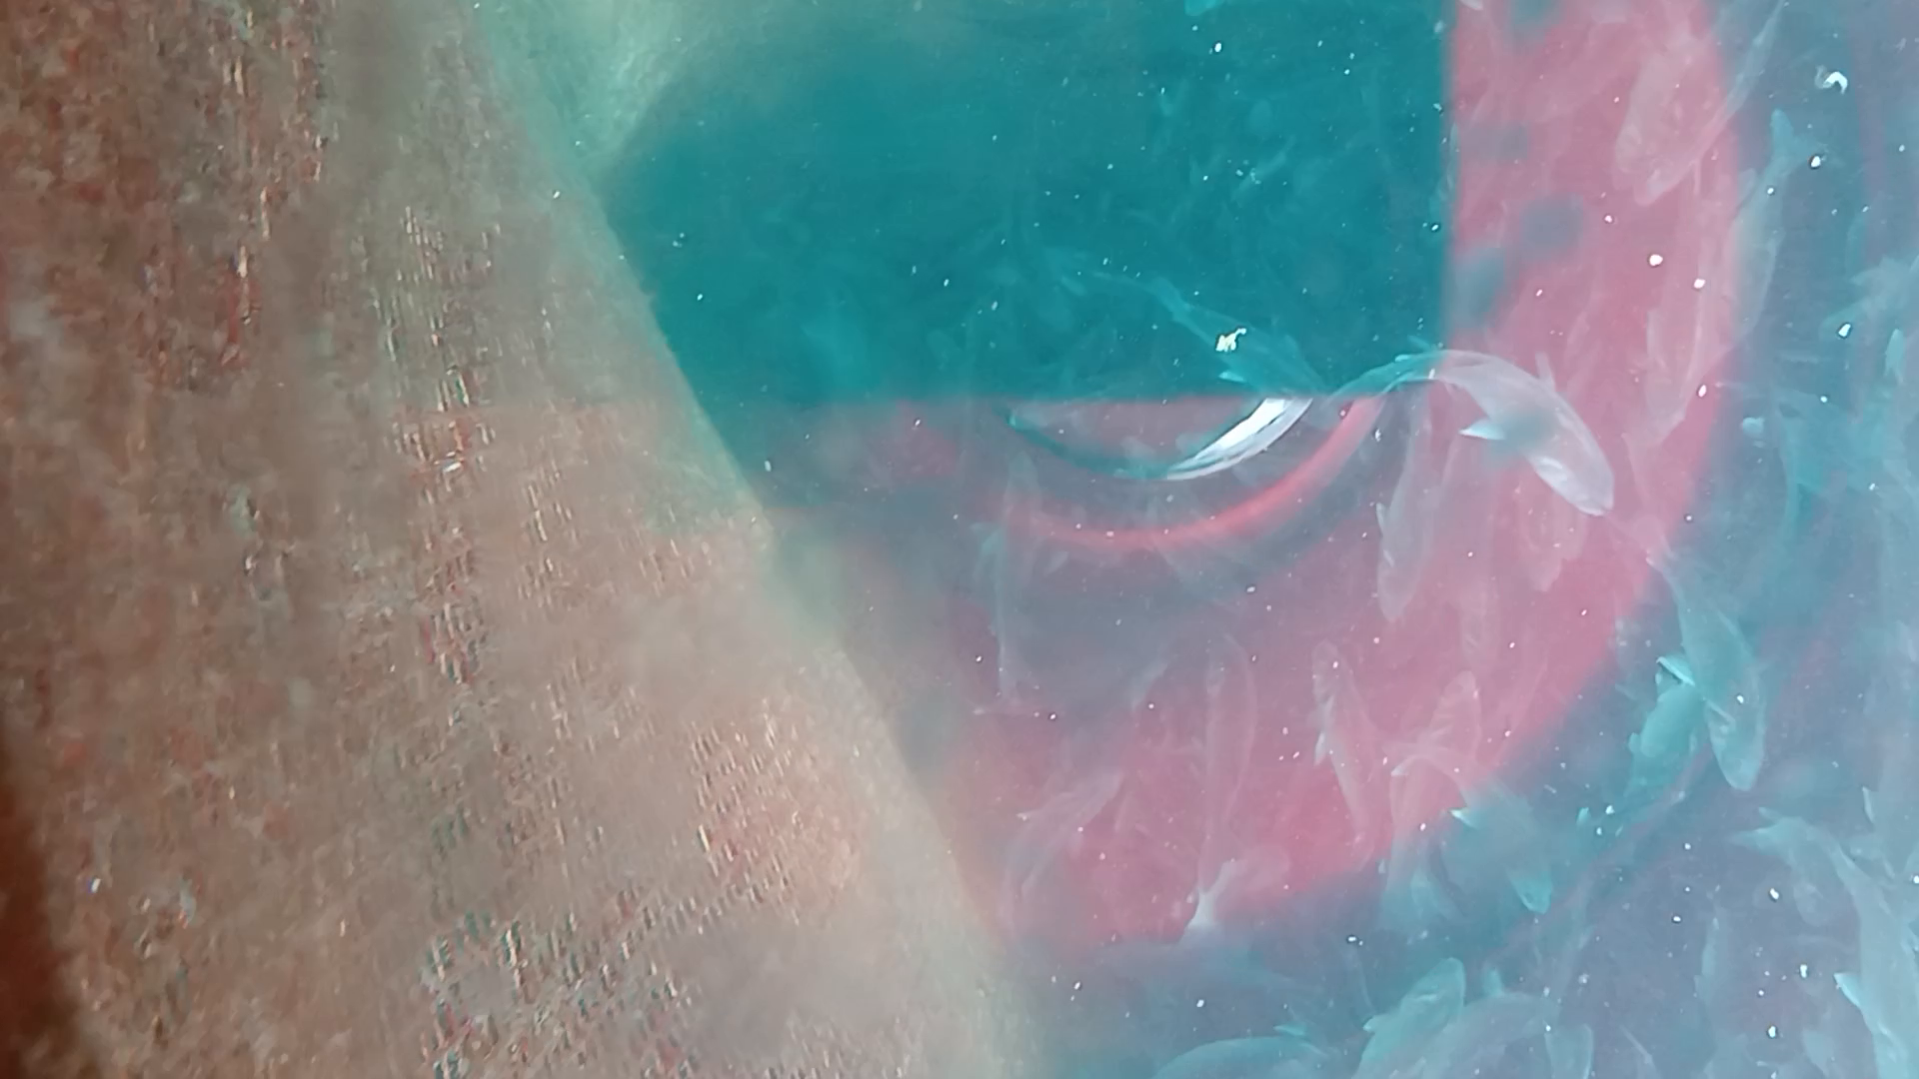

Slide 4
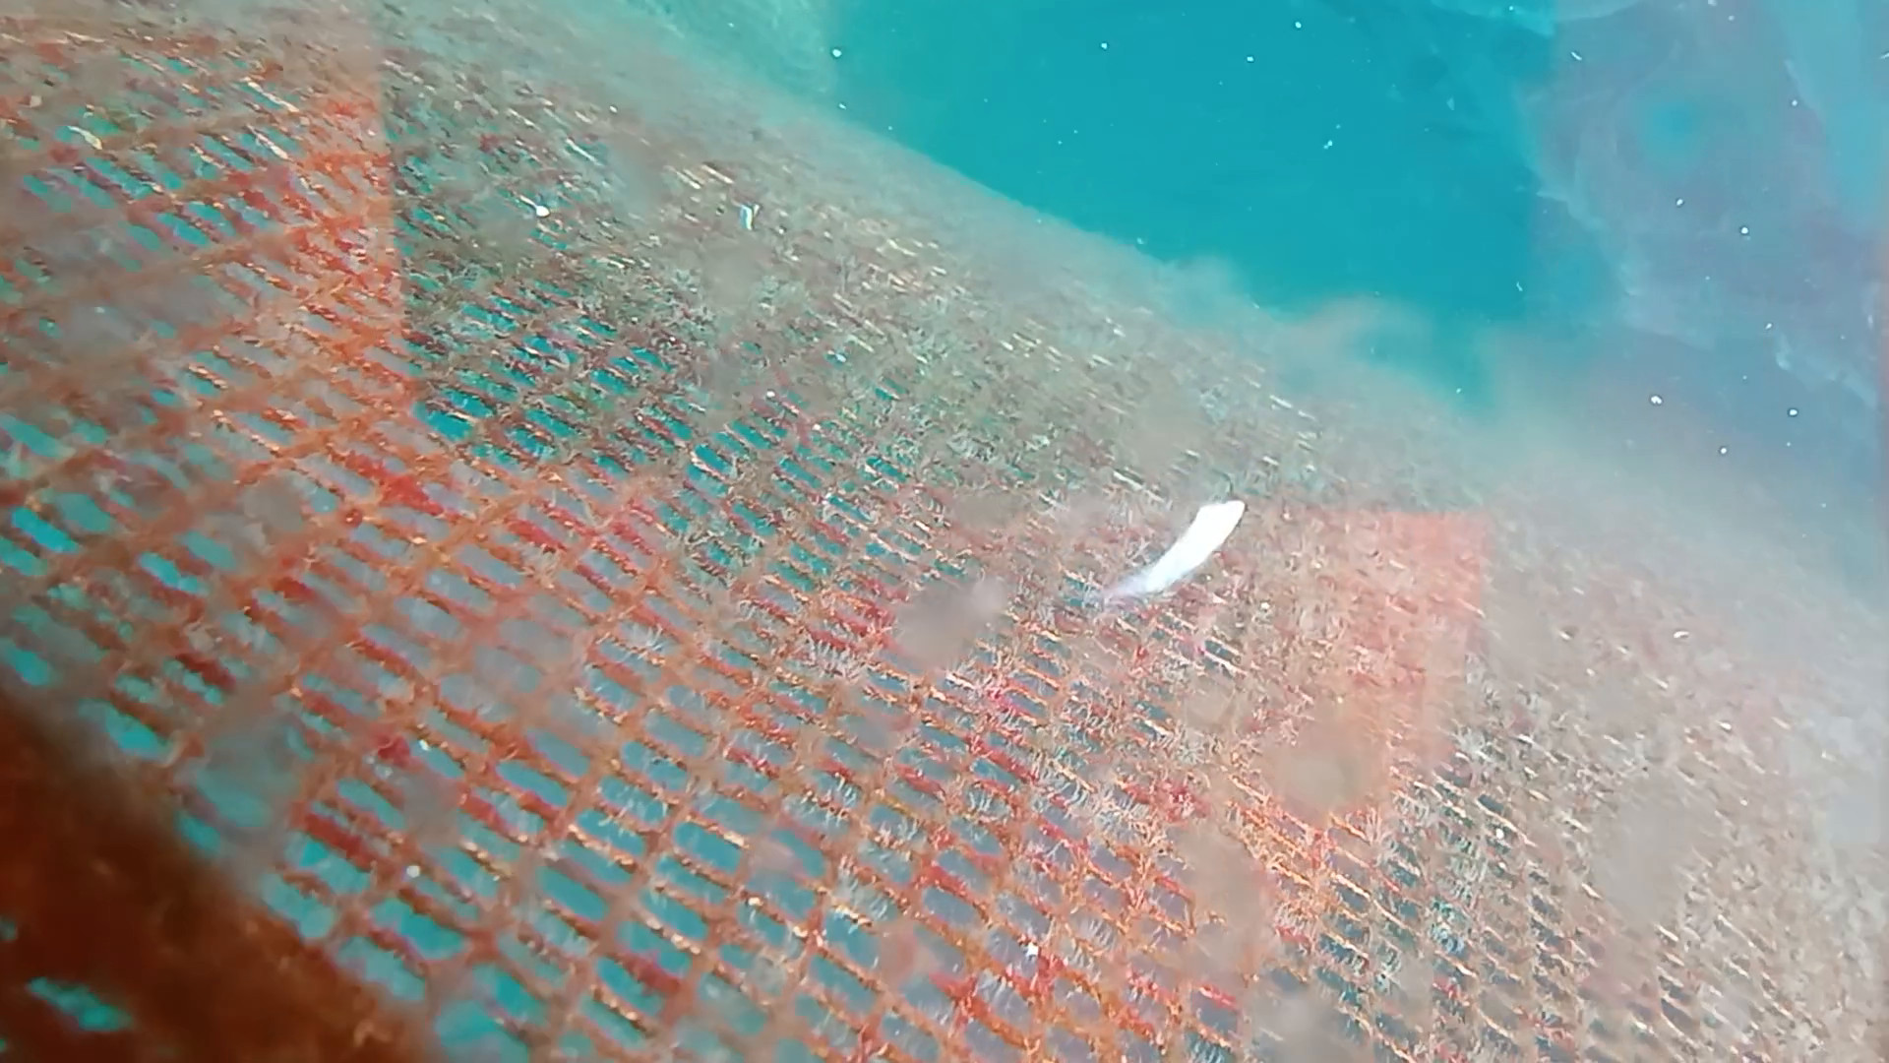
No fish

Slide 5
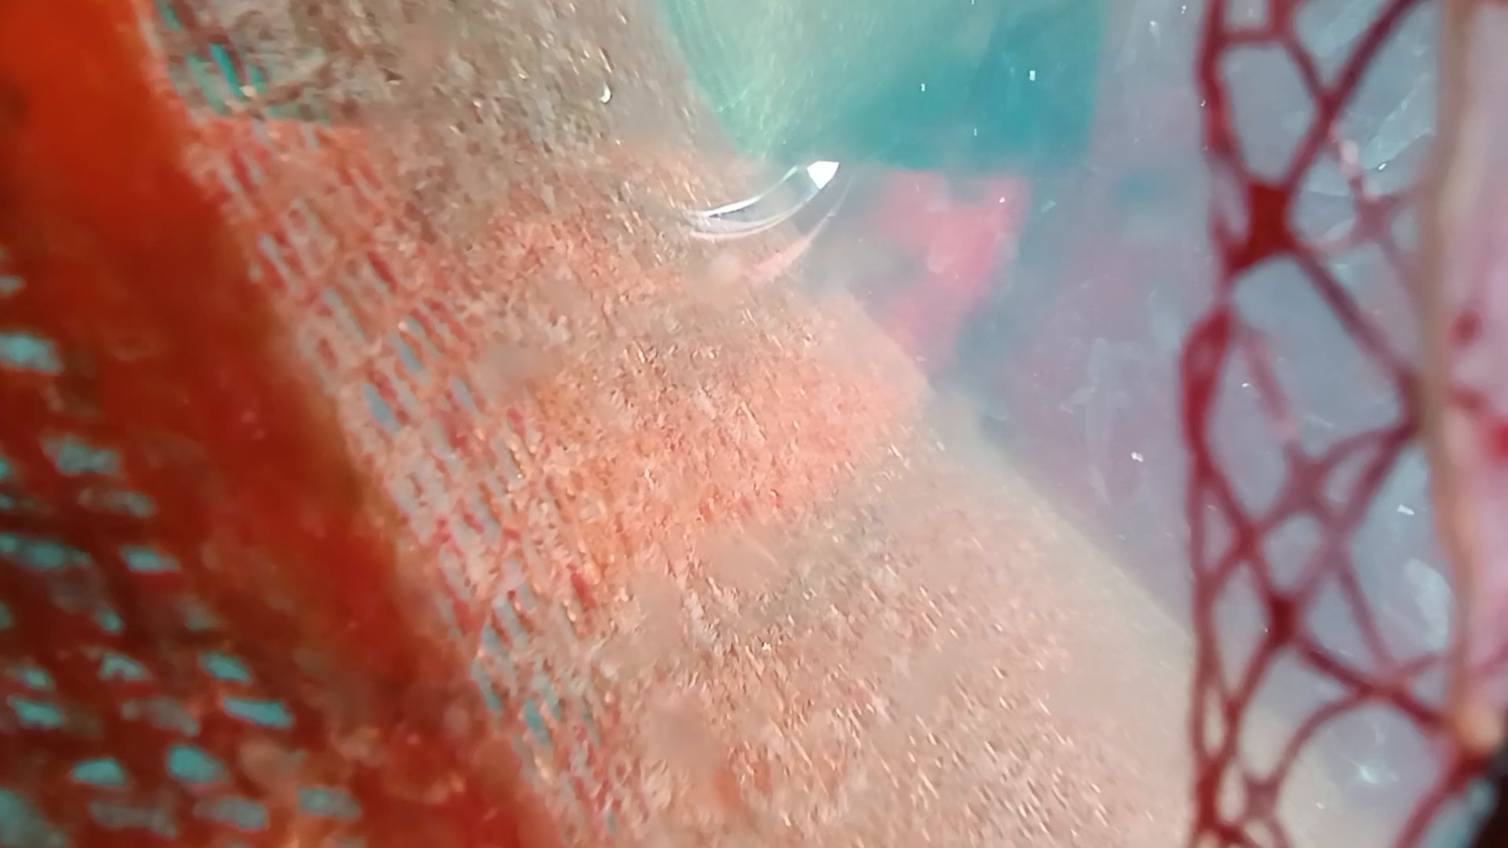
No fish behind the net

Slide 6
